Slide 1
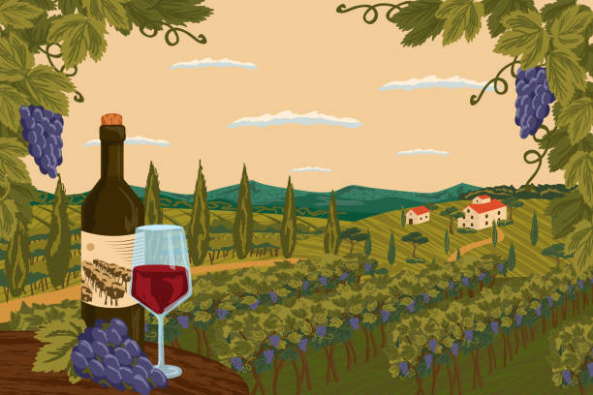
Bacchus wine case study
The Best Group
Joel Atkinson, Zac Baker, Kyle Klausen, Juan Macias Vasquez
Bellevue University
CSD310-H2323 Database Development & Use (2255-DD)
July 24, 2025

Slide 2
Team introduction
We are a committed team of four software development students from Bellevue University, brought together by our shared interest in improving our skillsets in not only database design, but software development as a whole.
Joel - A software development student who is working hard to grow his skills within the field in order to become a proficient full-stack developer. His current interests are more sided with the front end/design aspect of the field but also enjoys learning and working on the database/server back end of development as well.
Zac – A software development student who hopes to work towards becoming a full-stack developer. He is currently interested in working in web-development or desktop development.
Kyle – A software development student and he aspires to become a project manager for mobile app projects. He is actively working on his bachelor's degree to help with his progress in his career within tech. His current interests are front-end development and web-development.
Juan – A software development student and he is working towards getting his degree and then trying to obtain some programming certificates. He is currently interested in working with front end development but is starting to get more interested in things like optimization and making programs run better and on more hardware.

Slide 3

Case Study
Bacchus Winery, passed down to Stan and Davis Bacchus from their retired father, specializes in producing Merlot, Cabernet, Chablis, and Chardonnay using grapes grown on their own estate. Once passed down, it was important to keep all of their current employees, who had become like family over the years, as well as keeping their father's legacy alive by producing and selling the great tasting wines customers know and love.
Our job as developers is to bring the winery into the modern age and build them a database based on their needs to track employee hours, shipments of supplies from suppliers, and the sales of wine through distributors. From there, the data is printed and sent out as a report to Stan, Davis, Janet, & Roz in order to ensure the people of Bacchus Winery have the data they need to continue to grow and succeed.

Slide 4
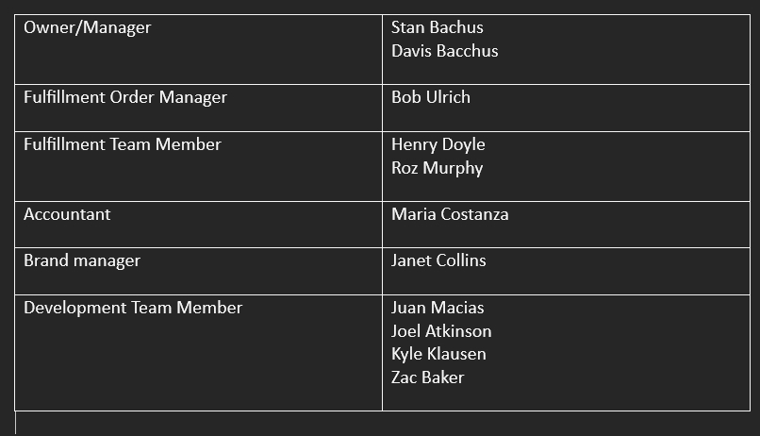
BUSINESS STRUCTURE
An organizational chart visually represents a company's internal structure, showing how roles, responsibilities, and authority are distributed. It helps clarify the hierarchy and communication flow within the business. In the chart provided, we can see Stan Bachus and Davis Bacchus serve as the Owners/Managers, overseeing the entire operation. Bob Ulrich is the Fulfillment Order Manager, while Henry Doyle and Roz Murphy are Fulfillment Team Members. Maria Costanza manages finances as the Accountant, and Janet Collins leads marketing as the Brand Manager. The Development Team Members include Juan Macias, Joel Atkinson, Kyle Klausen, and Zac Baker.

Slide 5
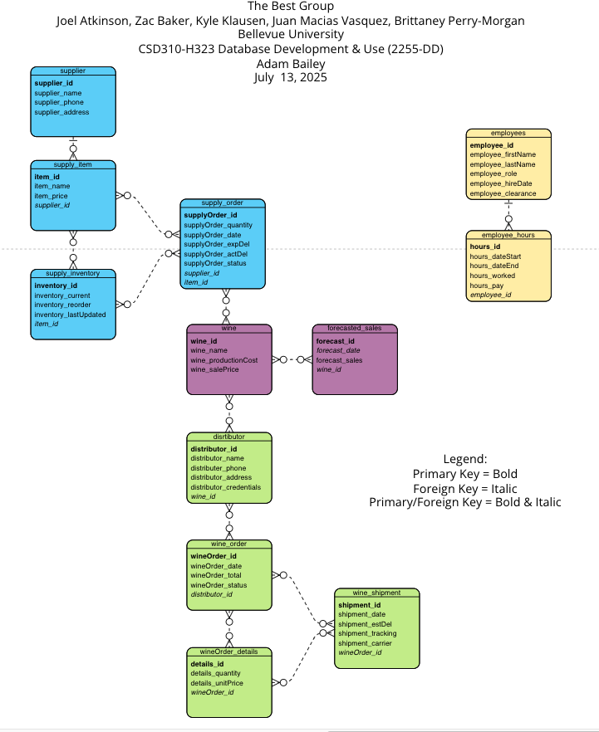
Our ERD
Provides a visual representation of the database design for Bacchus Winery, outlining the relationships between key entities involved in the winery's operations.
Maps out the tables within the Bacchus Winery database showing how they connect with each other and highlights the Primary Keys and Foreign Keys.
Addresses the wineries needs to monitor supplier deliveries, wine distribution/projected sales, & employee hours over the last 4 quarters.

Slide 6
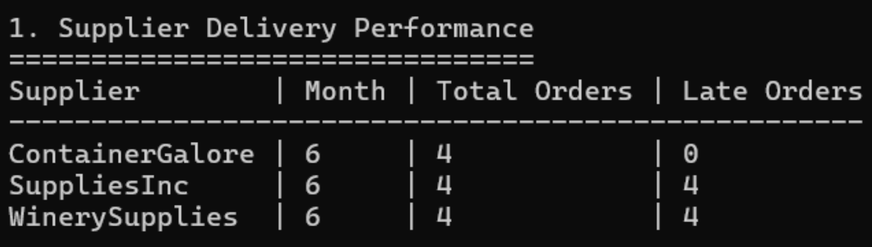
Supplier Delivery reports
This report tracks how often suppliers deliver on time and calculates the average delay in days when they’re late. We used the expected and actual delivery dates from each supply order to figure out how reliable each supplier is. The data is broken down by month and by supplier, so it’s easier to spot patterns—like whether certain suppliers tend to be late or if delays happen more often in specific months. This kind of report helps flag problem areas early so they can be addressed before they become bigger issues

Slide 7
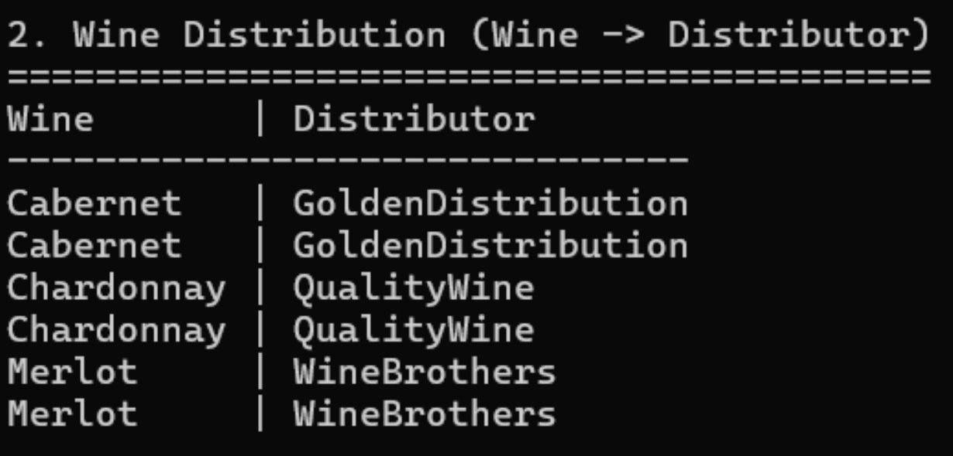
Wine distribution report
This report shows which distributor is handling which wines. It helps organize and visualize distribution channels, showing whether a wine is being distributed by one company or multiple. In this case, GoldenDistribution handles all Cabernet, QualityWine handles all Chardonnay, and WineBrothers is responsible for Merlot. This setup gives a clearer picture of distributor responsibility.

Slide 8
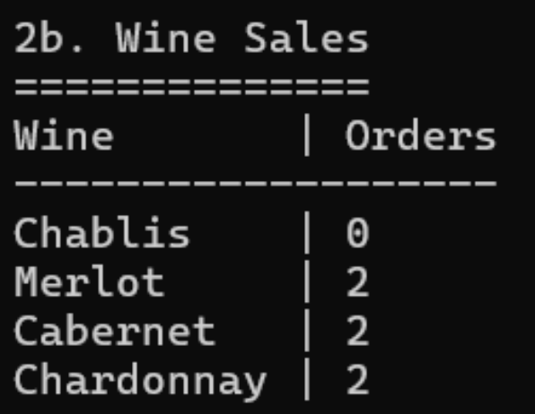
WINE SALES REPORT
Shows how many individual orders have included each type of wine. Rather than focusing on quantity sold, this report counts how many times each wine appeared in orders. It’s a quick way to gauge popularity across recent sales. Chablis, for example, has no recent orders, while the other three wines have each been ordered twice.

Slide 9
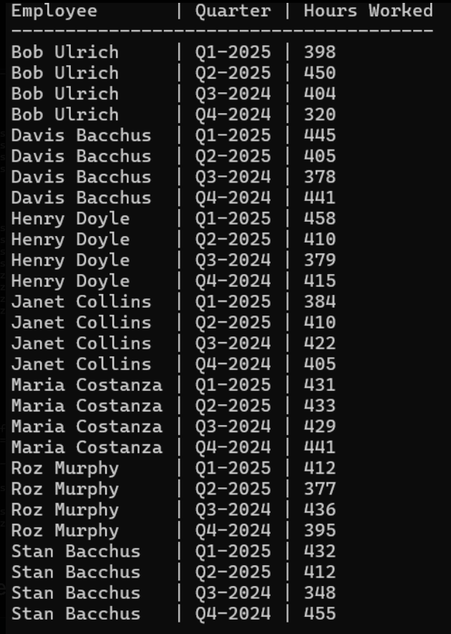
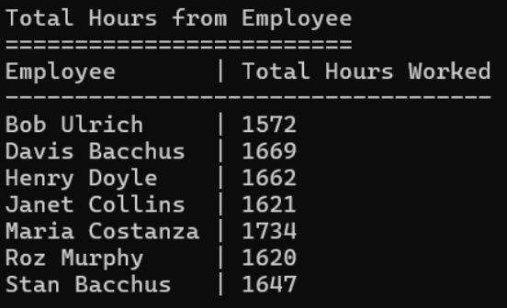
employee HOURS REPORT BY QUARTER and total
•Quarter report - This report shows how many hours each employee worked in each quarter, going back four quarters. It provides a full breakdown per employee, grouped by quarter, which is especially useful for tracking labor effort over time. For example, Maria Costanza consistently worked over 425 hours per quarter, while other employees had more variation. This satisfies the requirement to show quarterly labor performance and supports payroll and staffing analysis.
•Total report - This report adds up how many hours each employee worked across all four quarters. It’s helpful for getting a quick summary of the overall workload per person. While the quarterly report gives a breakdown over time, this one shows who’s been putting in the most time overall. It’s a good way to identify top contributors or spot imbalances in workload. For instance, our employee, maria costanza, clearly logs a lot of hours compared to others.

Slide 10
Assumptions
We made a few assumptions while working on this assignment to help guide our decisions. Since not all the details were provided in the case study, we had to fill in some of the gaps with what we believed made the most sense.
We assumed that the winery already has some basic systems in place for things like tracking inventory, employees, and orders. The database we created wasn’t meant to replace everything they use—it was more about improving the process and helping organize things like deliveries, sales, and hours worked.
We also tried to imagine how the winery might operate day to day—from getting supplies in, managing wine production, and sending out products through different distributors. Some of that wasn’t explained directly, so we had to use our best judgment based on what made sense for a business like this.
One example is employee tracking. We just used regular hours worked instead of getting into shift details or advanced scheduling. There wasn’t enough info to go deeper, and we didn’t want to assume too much.
Other specific assumptions we made:
• There’s already a basic database or system handling some of the core operations—we’re just building on top of that.
• The main areas that need improvement are delivery tracking, sales reporting, and employee hour tracking.
• We focused on comparing expected vs. actual results (like deliveries and hours) because that seemed to be the priority.
• Wine distribution is organized so that each distributor handles certain wines—this helps simplify reporting and planning.
• Since full data wasn’t given, we created example records to show how the system could work in a real situation.
These assumptions helped us stay focused on what mattered most and build a system that works—even if some of the pieces had to be imagined based on experience and common sense.

Slide 11
final THOUGHTS AND KEY TAKEAWAYS
This case study gave our team a better understanding of how real-world challenges are handled through thoughtful planning and teamwork. As we worked on our project, we saw clear connections between the case and our own process—especially in how important communication and adaptability are. When we hit roadblocks, we looked back at the case to guide our decisions and keep us aligned. The biggest takeaway for us is that successful outcomes depend on collaboration, flexibility, and learning from real examples. This experience helped us grow and gave us a better grasp of what teamwork looks like in practice.

